Slide 1

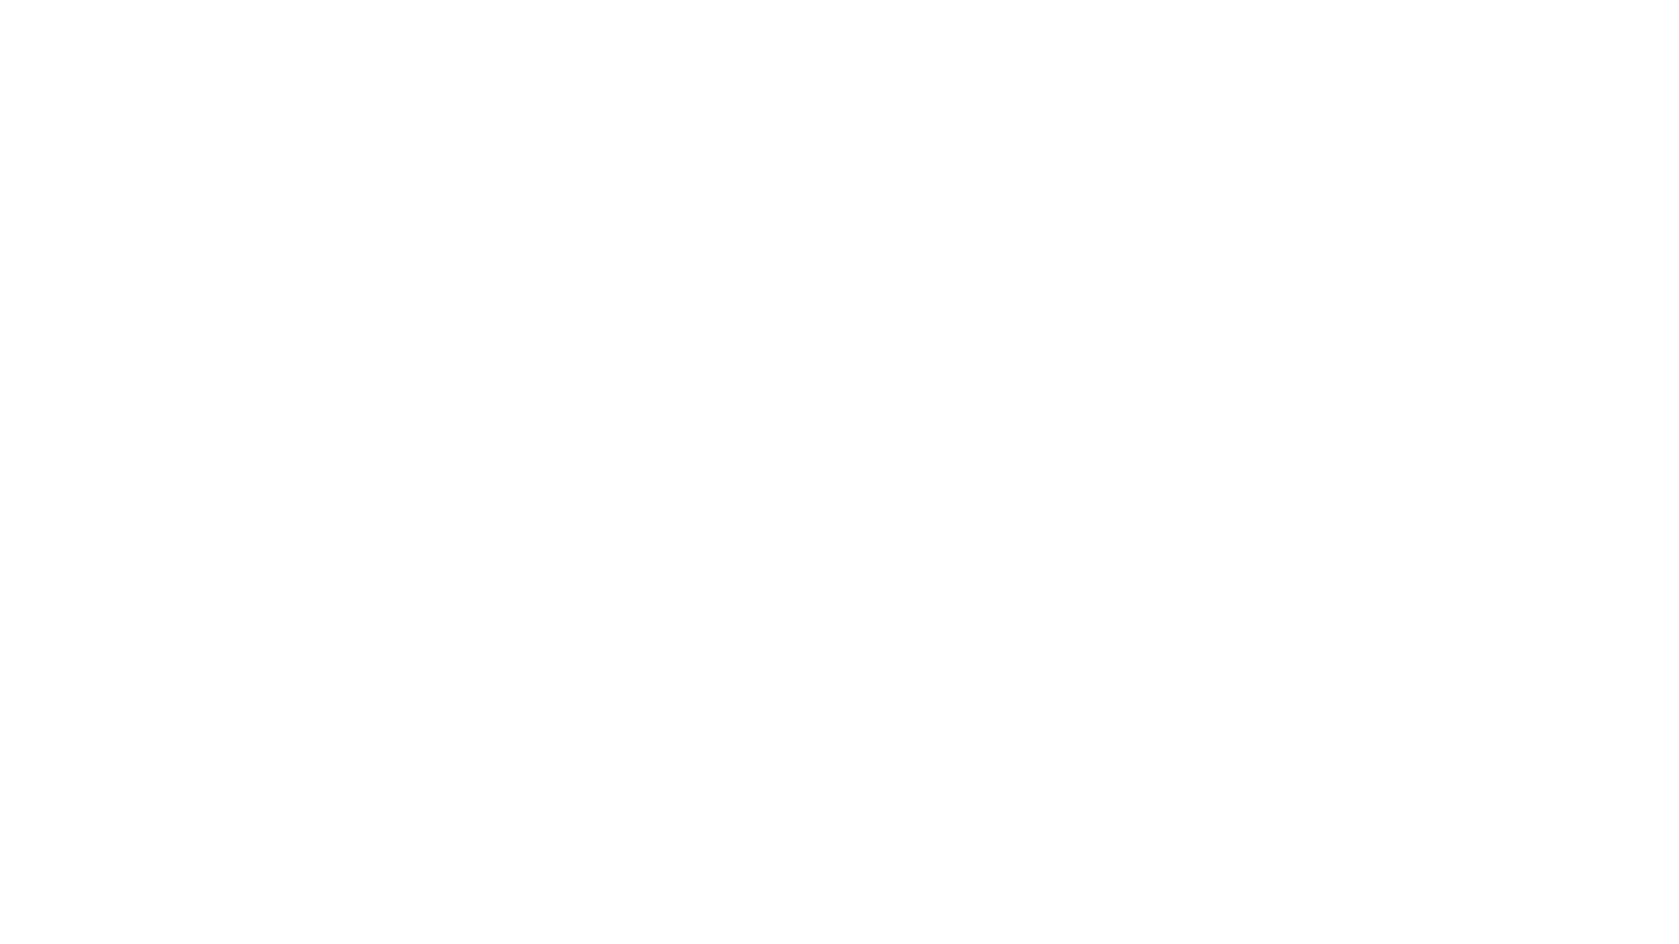


Predict Weather with Machine Learning by TSF
Created during internship at DS GROUP

Slide 2


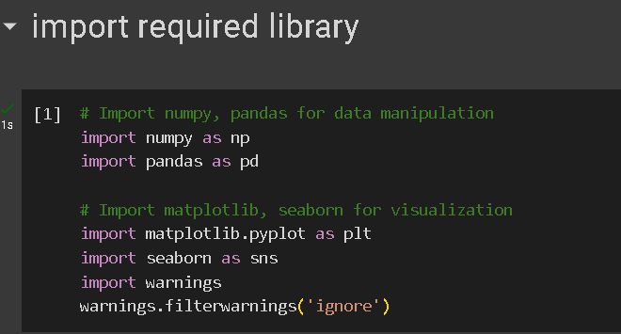
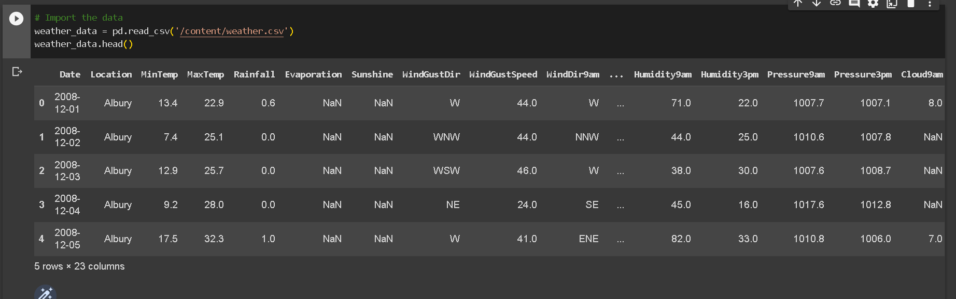
Computing Components
We have access to a century of historical averages of global temperatures, including global maximum temperatures, global minimum temperatures, and global land and ocean temperatures. Having all this, we know that this is a supervised regression machine learning problem.
To access source code https://colab.research.google.com/drive/1IGZti-xyKL0Low-uP9FQlRUiIu9PnYda?usp=sharing
NETWORK
PROCESSOR
CLOUD COMPUTING
SERVER

Slide 3
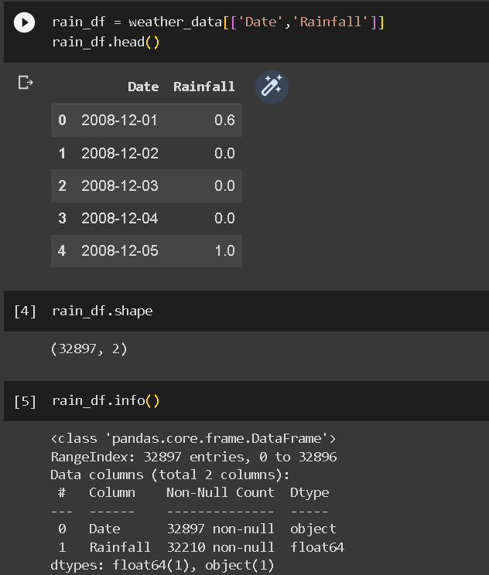
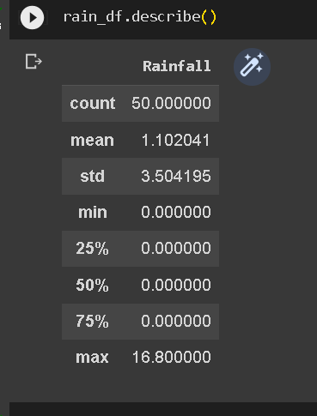
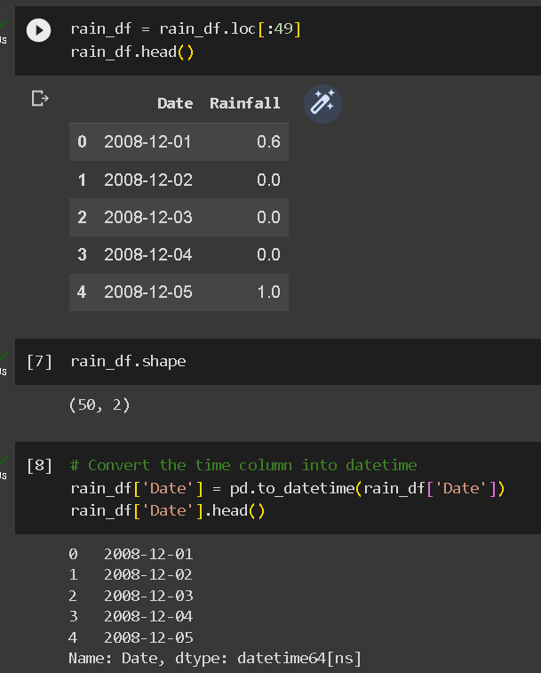
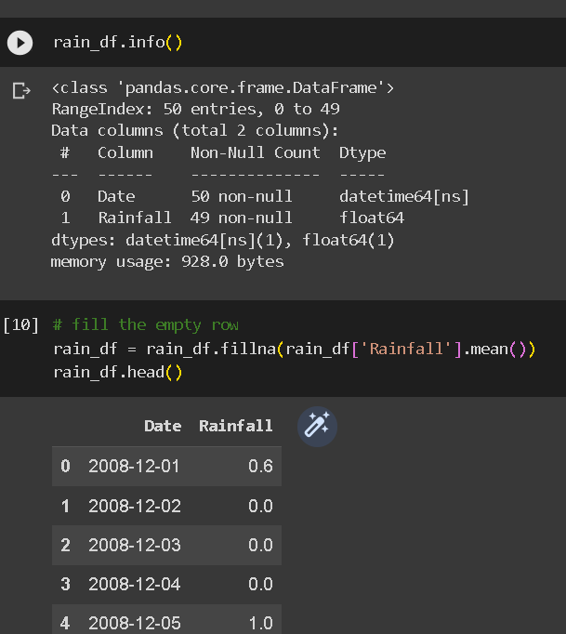
Distribution
Getting inside about data

Slide 4
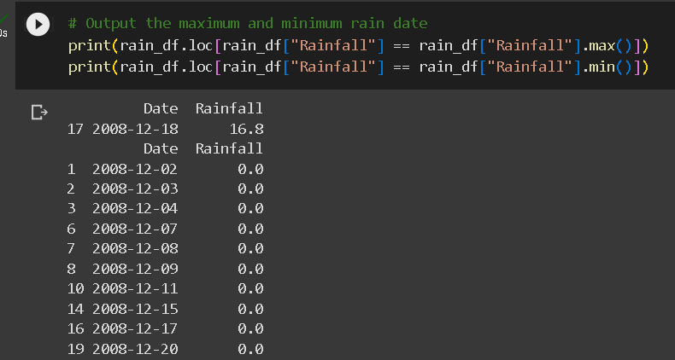
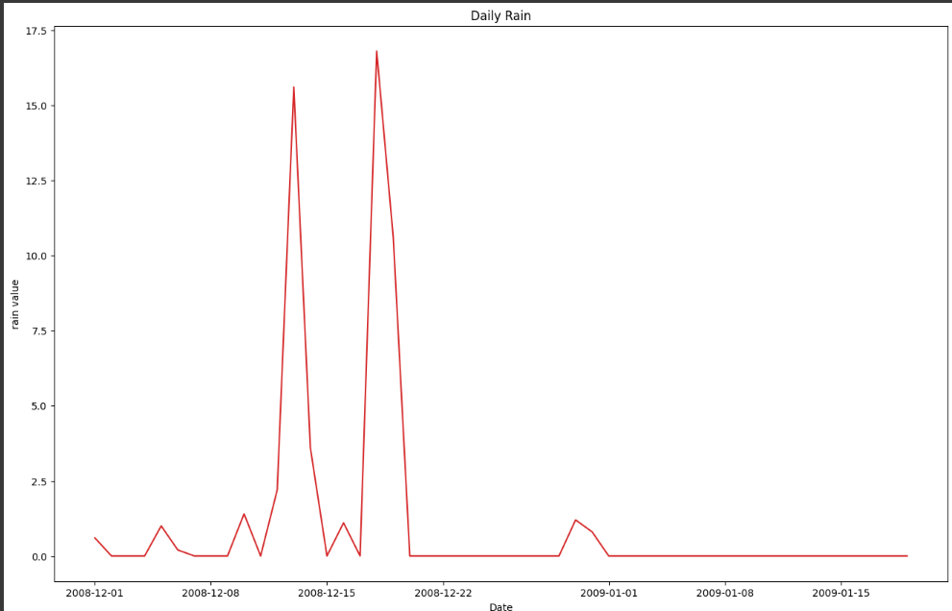
Process
Access needed
Determine scale
Select technology
Plot the daily temperature change
Plot the daily temperature change
Plot the daily temperature change

Slide 5
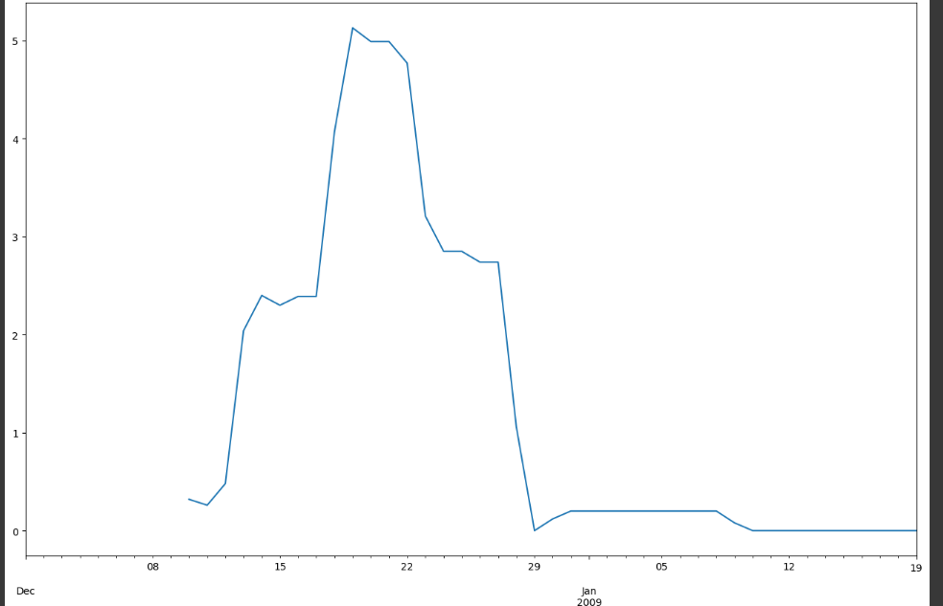
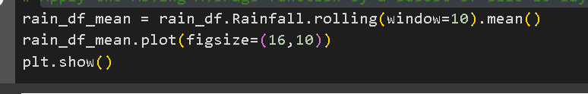

Contact details
Apply the Moving Average function by a subset of size 10 days.
someone@example.com

Slide 6
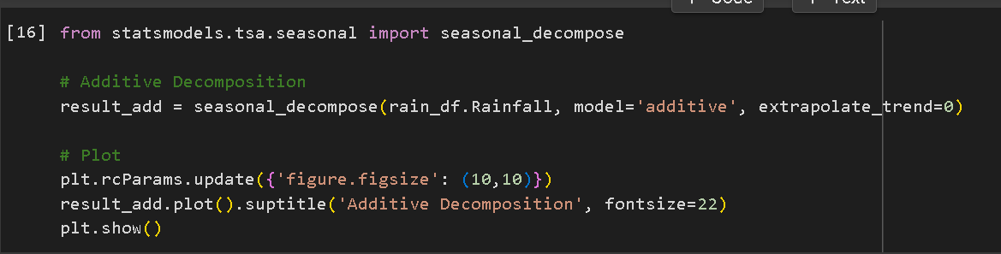
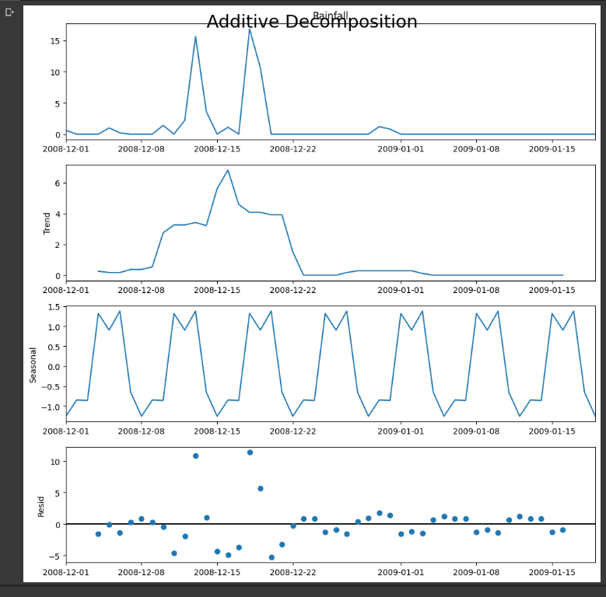
In seasonal_decompose we have to set the model. We can either set the model to be Additive or Multiplicative. A rule of thumb for selecting the right model is to see in our plot if the trend and seasonal variation are relatively constant over time, in other words, linear. If yes, then we will select the Additive model.
Additive decomposition argues that time series data is a function of the sum of its components. Thus, where Y is the time series data, T is the trend-cycle component, S is the seasonal component, and R is the remainder.
Shift the current rain to the next day.

Slide 7
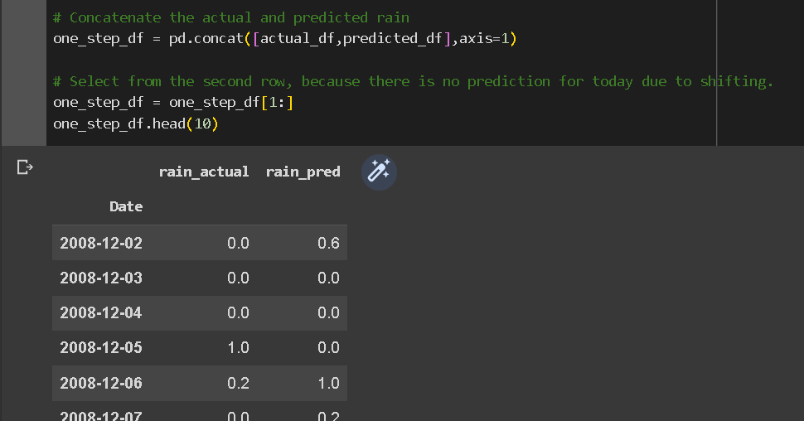
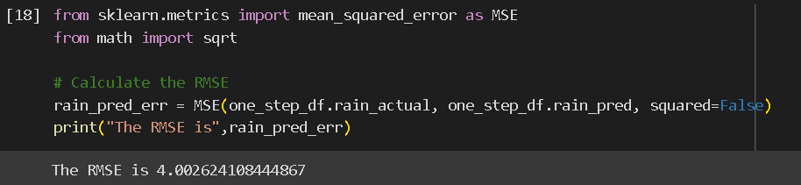
Here you can the we have two column one is our actual rain column and other is predicted rain column that we use next model
We could validate how well our model is by looking at the Root Mean Squared Error(RMSE) between the predicted and actual rain
Our RMSE value is 4.002 is around 4 that are pretty good for model.

Slide 8
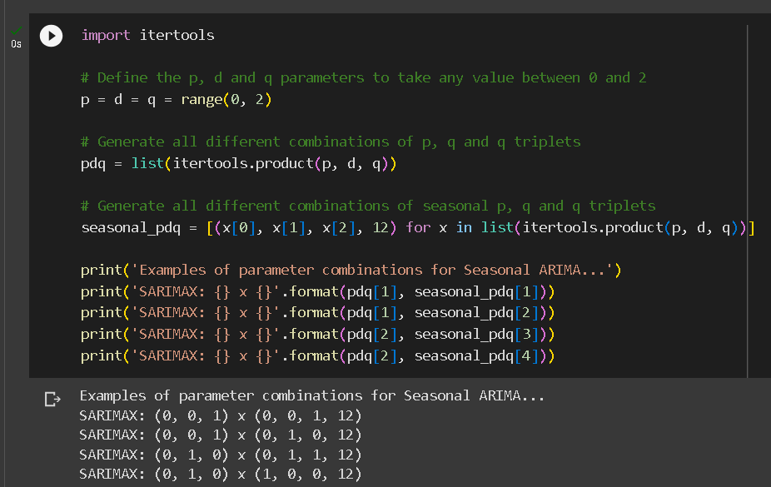
Using SARIMA model(extension of ARIMA that can account for seasonal patterns in the data) Parameter Selection Grid Search We are going to apply one of the most commonly used method for time-series forecasting, known as SARIMA, which stands for Seasonal Autoregressive Integrated Moving Average. SARIMA models are denoted with the notation SARIMA(p,d,q)(P,D,Q,s). These three parameters account for seasonality, trend, and noise in data: We will use a “grid search” to iteratively explore different combinations of parameters. For each combination of parameters, we fit a new seasonal SARIMA model with the SARIMAX() function from the statsmodels module and assess its overall quality.
Forecast Diagnostic
It is also useful to quantify the accuracy of our forecasts. We will use the MSE (Mean Squared Error), in which for each predicted value, we compute its distance to the true value and square the result

Slide 9
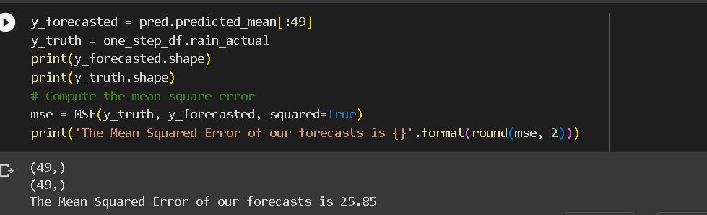
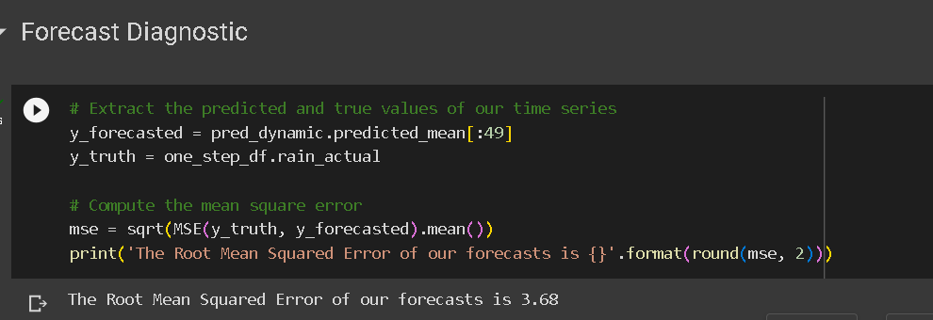
Amazing!!! Our forecast model forecasts the rain with only an error of 25.85.
In the weather forecast field, the prediction error of 2.19 degrees seems promising and sufficient, as there are many other factors that contribute to the change in rain, including but not limited to the wind speed, the air pressure, etc.
The predicted values obtained from the dynamic forecasts yield an MSE of 3.68. This is significantly higher than the one-step ahead, which is to be expected given that we are relying on less historical data from the time series.

Slide 10
Conclusion
I implemented seasonal SARIMA model in Python. I made extensive use of the pandas and stats models ( provides classes and functions for the estimation of many different statistical models)libraries and showed how to run model diagnostics, as well as how to produce forecasts of the Rain.
transition to another season signaling through the rainfall should gradually occur, unless there is any disastrous factors such as storm, drought, etc.
large quantity of observation data including surface observations, satellite imagery, radar data, radiosonde data, upper-air data, wind profilers, aircraft observations, river gauges, and simply looking outside.

Slide 11


